Slide 1
Customer churn prediction

Slide 2
Customer churn prediction
Project definition
Project title
What is churn prediction? Churn prediction is predicting which customers are at high risk of leaving your company or canceling a subscription to a service, based on their behavior with your product.
Analysing demographic characteristics of marginal workers in Tamil Nadu

Slide 3
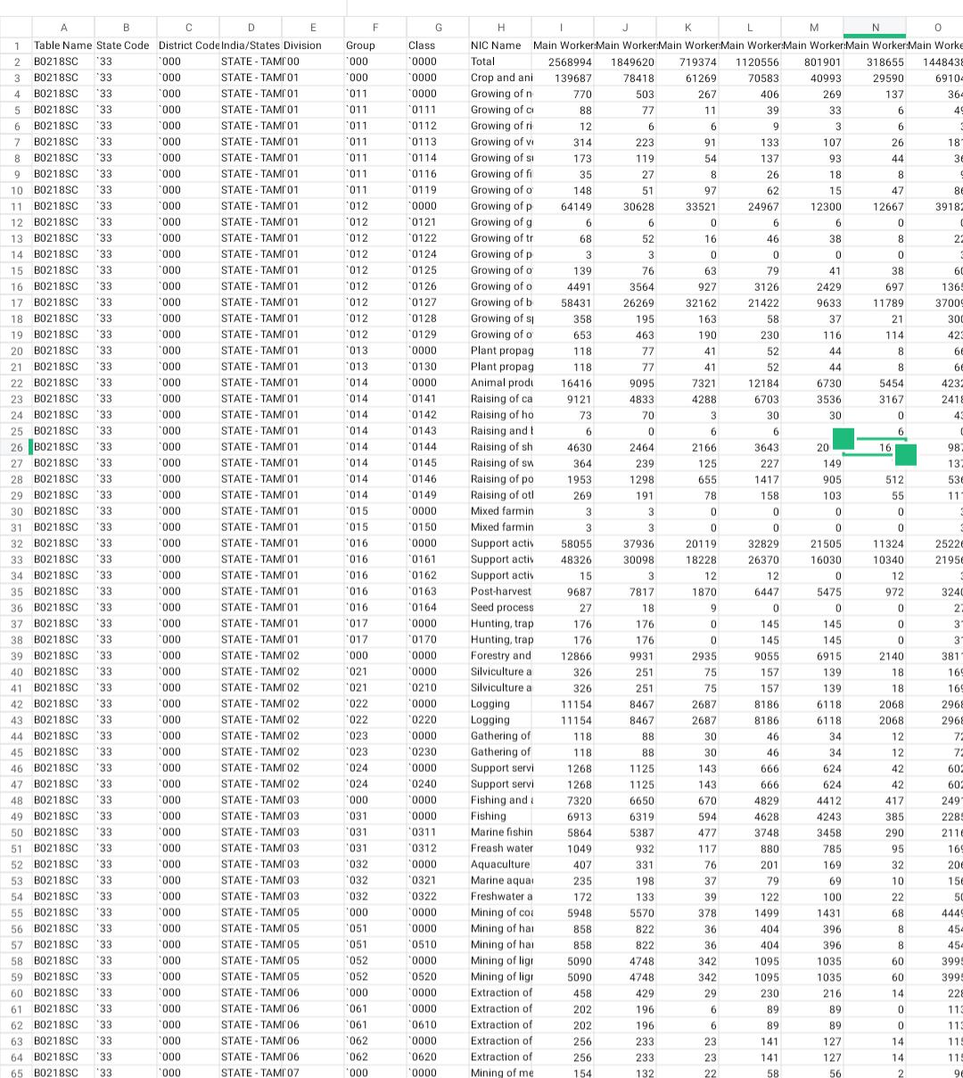
Demographic analysis
Industrial category analysis
Demographic analysis is the collection and analysis of broad characteristics about groups of people and populations.
Demographic data is very useful for businesses to understand how to market to consumers and plan strategically for future trends in consumer demand.
The combination of the internet, big data, and artificial intelligence is greatly amplifying the usefulness and application of demographics as a tool for marketing and business strategy.

Slide 4
Socioeconomic Insights
This paper examines the socio-economic condition of the migrant workers in Tamil Nadu.We analyse the income, consumption and savings pattern, and nature of work of the migrant workers in the Thiruvananthapuram district, based on data from a sample of 166 migrant workers. While existing studies provide evidences for short distance migration to Kerala from nearby states like Tamil Nadu and Karnataka, we find evidence for long distance migration from states like West Bengal and Assam in recent years. We find that informal information networks through migrant workers from native place plays important role in migration of workers to Kerala. Poor economic conditions in the native place and high wage rate and better employment opportunities in Kerala have been identified as the main reasons of migration to Kerala. Though there is barely any change in the nature of employment of the migrants even after migration, there has been a shift from the low-income brackets before migration to high-income brackets after migration. Notwithstanding the improved income level the living condition for most of migrant workers is deplorable, most of them live together in either poor rented houses or work sites with one room shared by many, without proper provision of hygienic sanitation.

Slide 5
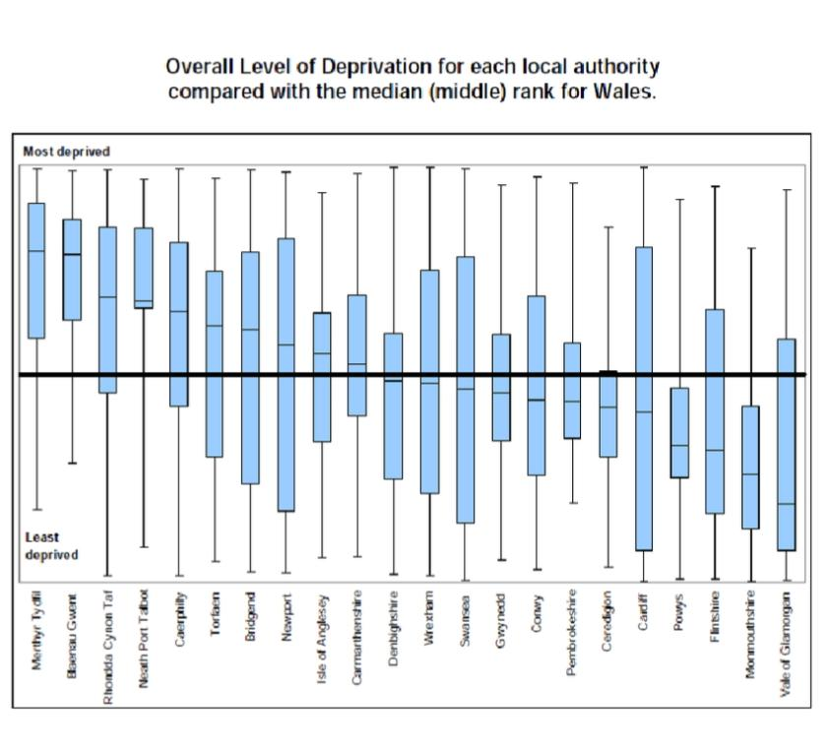
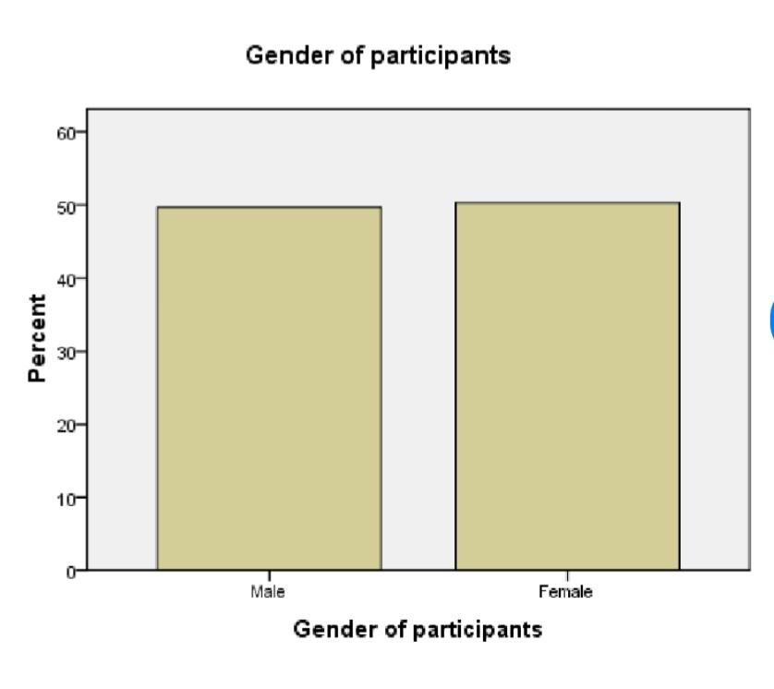
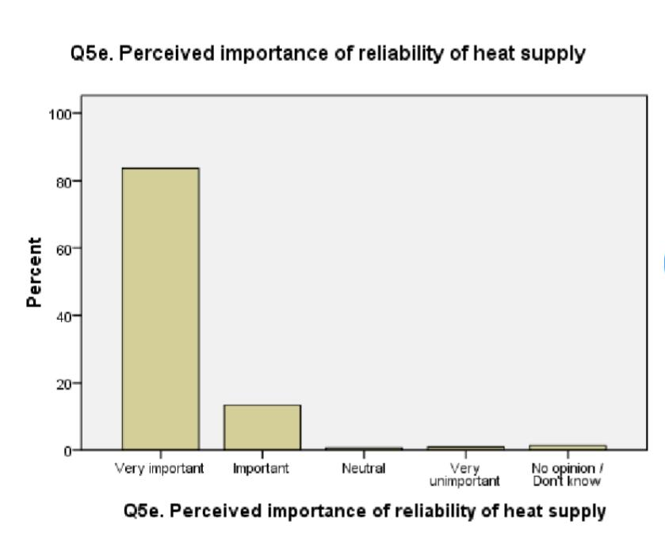
Approach

Slide 6
Conclusion
Empowers marketers to easily collect & process data from nearly any online source. Create a multiplier effect that enables marketers to maximise the efficiency. Customer Experience

